Slide 1
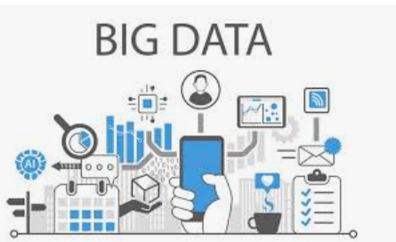
What is Big Data?
Big Data refers to extremely large and complex datasets that cannot be effectively processed, stored, or analyzed using traditional data processing applications.

Slide 2
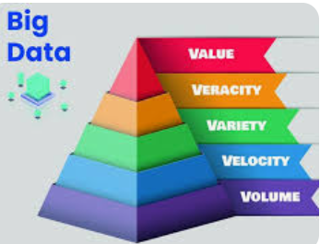
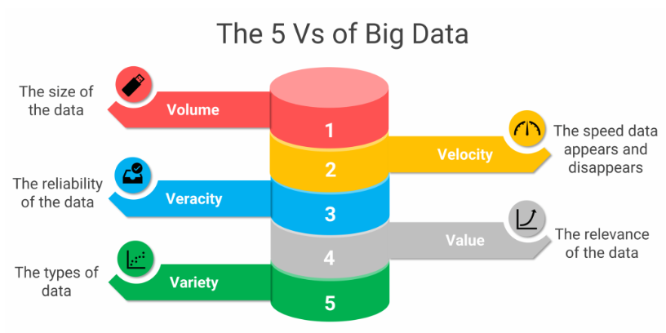
What are the 5 V's of Big Data?
Volume (amount of data), Velocity (speed of data generation), Variety (different data types), Veracity (accuracy), and Value (usefulness).

Slide 3
What is Big Data Analytics?
It is the process of examining large and diverse data sets to uncover hidden patterns, unknown correlations, market trends, customer preferences, and other useful business information.
Big data analytics refers to the systematic processing and analysis of large amounts of data and complex data sets, known as big data, to extract valuable insights.
Big data analytics allows for the uncovering of trends, patterns and correlations in large amounts of raw data to help analysts make data-informed decisions.
This process allows organizations to leverage the exponentially growing data generated from diverse sources, including internet-of-things (IoT) sensors, social media, financial transactions and smart devices to derive actionable intelligence through advanced analytic techniques.

Slide 4
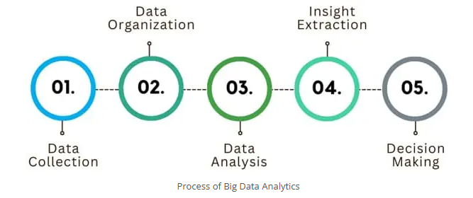
Process of Big Data Analytics
Data Collection: Gathering vast amounts of data from diverse sources, including social media, sensors, transactional records, and more.
Data Organization: Structuring and categorizing data to make it manageable. This often involves cleaning the data to remove inaccuracies and inconsistencies.
Data Analysis: Applying various analytical methods to extract meaningful patterns and insights from the data. Techniques include statistical analysis, machine learning, and data mining.
Insight Extraction: Interpreting the results to identify trends, patterns, and correlations that can inform business decisions or solve problems.
Decision Making: Using the insights gained to make informed, data-driven decisions that can lead to improved outcomes and efficiency.

Slide 5
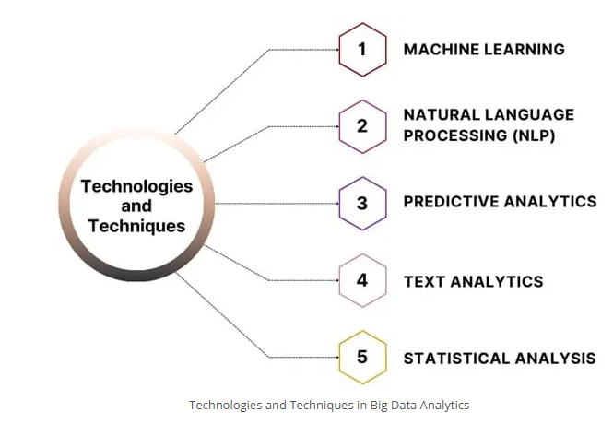
Technologies and Techniques in Big Data Analytics

Slide 6
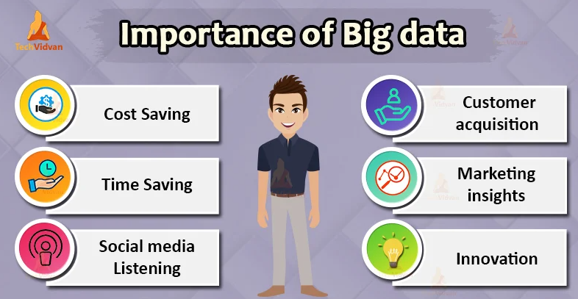
Importance of Big Data

Slide 7
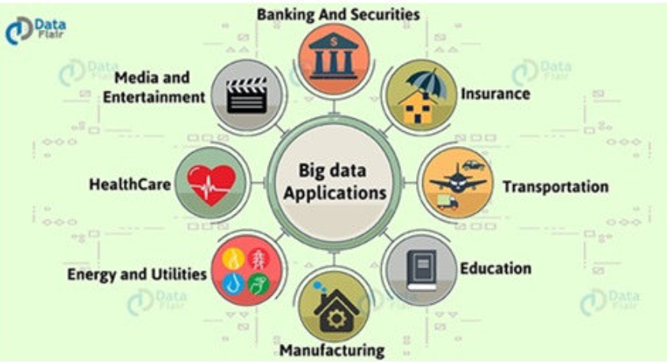
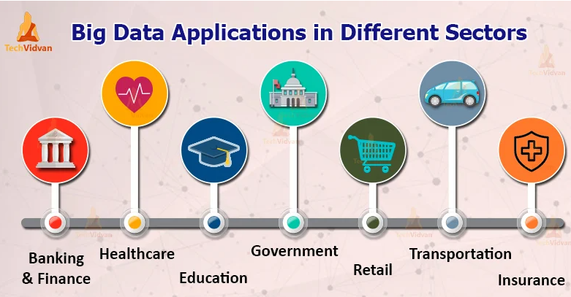
Applications of Big Data

Slide 8
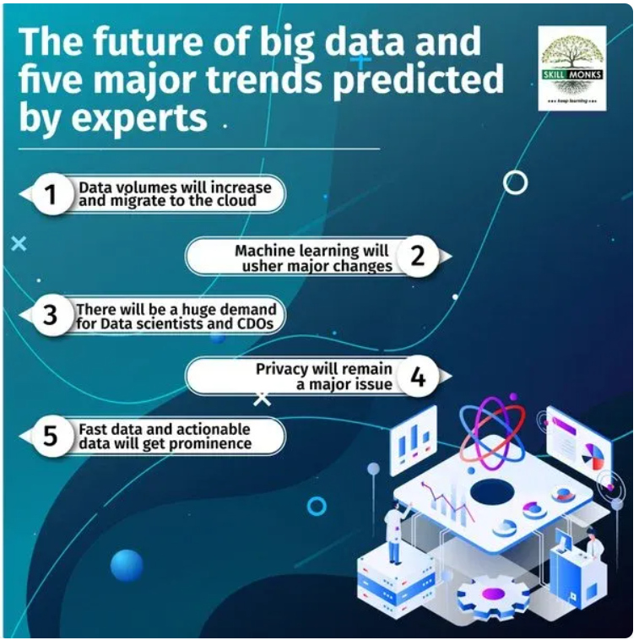
Big Data Future

Slide 9
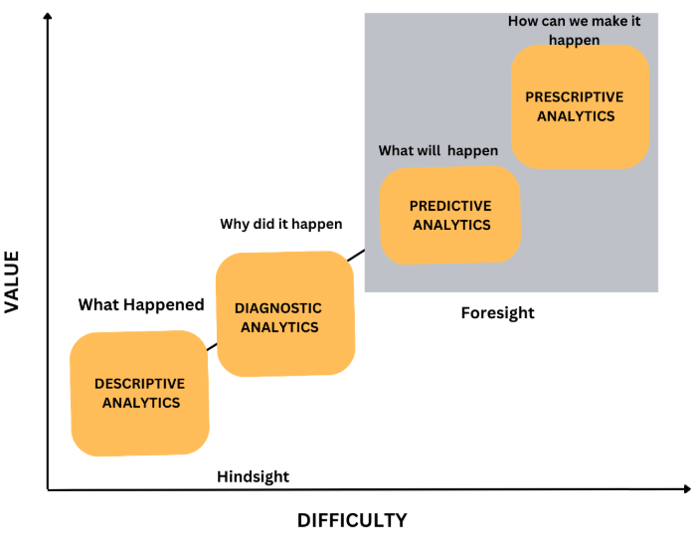
What are the four types of Big Data Analytics?
Descriptive Analytics: Answers the question: "What has happened?" (e.g., reporting, dashboards).
Diagnostic Analytics: Answers the question: "Why did it happen?" (e.g., drilling down, data discovery).
Predictive Analytics: Answers the question: "What is likely to happen?" (e.g., forecasting, machine learning).
Prescriptive Analytics: Answers the question: "What should we do?" (e.g., optimization, recommendation engines).

Slide 10
How is Big Data Analytics different from traditional analytics?
It handles diverse data types and massive volumes with distributed computing frameworks like Hadoop and Spark.

Slide 11
What is Hadoop? An open-source framework for distributed storage (HDFS) and processing of Big Data using MapReduce.

Slide 12
What is Apache Spark? A fast in-memory data processing engine used for big data analysis, offering speed advantages over MapReduce.

Slide 13
What types of data are analyzed in Big Data? Structured, semi-structured, and unstructured data from sources like social media, sensors, transactions, and logs.

Slide 14
What is MapReduce? A programming model for processing large datasets with a distributed algorithm on a cluster.

Slide 15
What challenges exist in Big Data Analytics? Data quality, integration from multiple sources, scalability, real-time processing, and data security.

Slide 16
How does Big Data help decision making? By providing insights from large datasets that improve operational efficiency, customer targeting, and risk management.

Slide 17
What are common tools used in Big Data Analytics? Hadoop, Spark, Kafka (real-time streaming), Hive (SQL querying), NoSQL databases (MongoDB, Cassandra).

